Slide 1
APPLICATION OF FINITE AUTOMETA IN SEARCH ENGINES
KALyan chakravarthy
21bai1759
THEORY OF COMPUTATION

Slide 2
Content
FINITE AUTOMETA
SEARCH ENGINES
BENFITS AND CHALLENGES
APPLICATONS OF FINTIE AUTOMETA IN SEARCH ENGINES
CONCLUSION

Slide 3
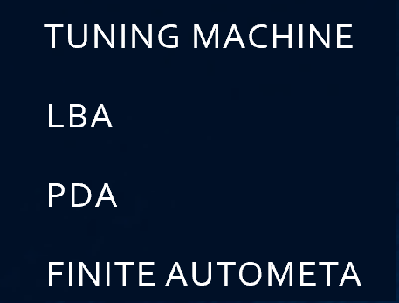
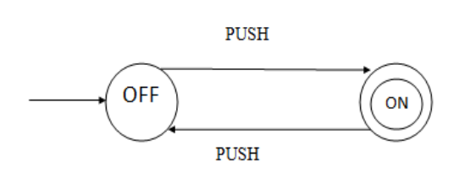
FINITE AUTOMETA
as abstract machines that have a finite number of states and transitions based on input symbols
Finite automata (FA) are abstract computational models that recognize patterns within input. They have a finite number of states and transitions between those states based on input symbols. A FA starts in an initial state and reads input symbols one at a time, transitioning between states until it reaches the end of the input. If the FA is in an accepting state, it accepts the input; otherwise, it rejects it.
There are two types of FA:
1)Deterministic (DFA)
2)Nondeterministic (NFA)

Slide 4
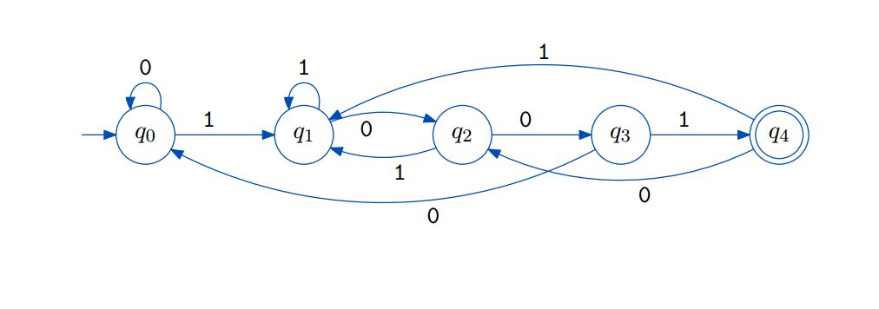
A finite automaton is a collection of 5-tuple (Q, ∑, δ, q0, F):
Q: set of states
∑: set of the input symbol
q0: initial state
F: final state
δ: Transition function

Slide 5
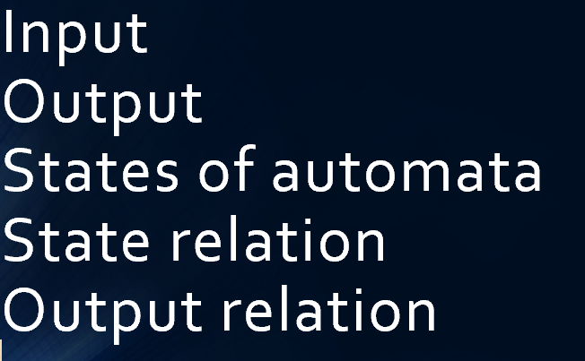
Deterministic Finite Automata (DFA): In a DFA, for a particular input character, the machine goes to one state only. A transition function is defined on every state for every input symbol. Also in DFA null (or ε) move is not allowed, i.e., DFA cannot change state without any input character. One important thing to note is, there can be many possible DFAs for a pattern. A DFA with a minimum number of states is generally preferred. Nondeterministic Finite Automata(NFA): NFA is similar to DFA except following additional features: Null (or ε) move is allowed i.e., it can move forward without reading symbols. Ability to transmit to any number of states for a particular input. However, these above features don’t add any power to NFA. If we compare both in terms of power, both are equivalent. Due to the above additional features, NFA has a different transition function, the rest is the same as DFA.

Slide 6
PUSH DOWN AUTOMETA A push down automata (PDA) is a way to implement a context free grammar (CFG) in a similar way to design the deterministic finite automata (DFA) for a regular grammar. A DFA can remember a finite amount of information but a PDA can remember an infinite amount of information. PDA is as follows −"Finite state machine+ a stack" PDA has three components, which are as follows − An input tape. A control unit. A stack with infinite size. Turing Machine A Turing machine is a computational model, like Finite Automata (FA), Pushdown automata (PDA), which works on unrestricted grammar. The Turing machine is the most powerful computation model when compared with FA and PDA. Formally, a Turing machine M can be defined as follows − M = (Q, X, ∑, δ, q0, B, F)

Slide 7
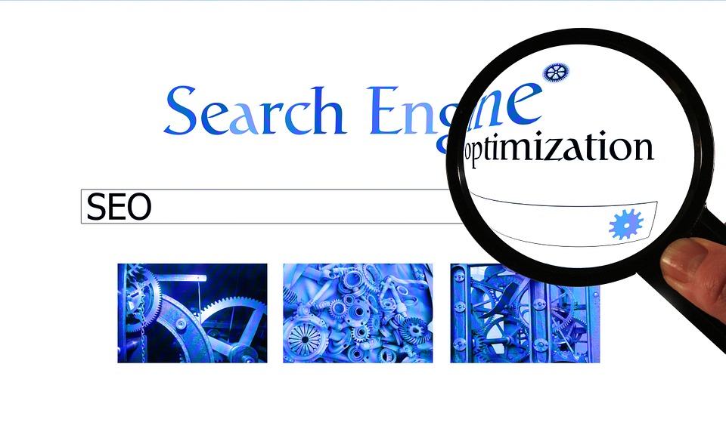
SEARCH ENGINES
Search engines are software systems designed to search for information on the World Wide Web. They work by using a combination of techniques such as indexing, crawling, ranking and querying to provide users with relevant and accurate search results.

Slide 8
Indexing: search engines create an index of all the web pages they know about. This index contains information about the content of each page, such as the words it contains and their locations on the page. The index is used to quickly find pages that match a user’s search query. Crawling: search engines use automated programs called crawlers or spiders to discover new pages on the web. These crawlers follow links from one page to another, adding new pages to the search engine’s index as they go. Ranking: when a user enters a search query, the search engine uses its ranking algorithms to determine which pages in its index are most relevant to the query. These algorithms take into account many factors such as the content of each page, its popularity and its relevance to the query. Querying: once the search engine has determined which pages are most relevant to a user’s query, it presents them in a ranked list of search results. The user can then click on any of these results to visit the corresponding web page.

Slide 9
FINITE AUTOMETA IN SEARCH ENGINE
Finite autometa are used in search engines to help the search algorithms.They are used to identify patterns in the data and generate predictions. The autometa are also used to design and analyze the algorithms. The finite autometa help search engines to be more efficient and effective.

Slide 10
BENFITS AND CHALLENGES
Benefits :
Speed: FA can be used to quickly find all possible completions for a given prefix in an auto-completion feature.
Accuracy: fa can be used to accurately represent all possible completions for a given prefix.
Simplicity: fa can be relatively simple to implement and understand.

Slide 11
BENFITS AND CHALLENGES
challenges:
Complexity: building a minimal deterministic automaton from a large set of terms can be computationally expensive and complex.
Scalability: as the number of terms increases, the size of the automaton can grow significantly, making it more difficult to store and search efficiently.
Expressiveness: fa may not be able to represent all possible queries or search features that a user may want to use.
Overall, using FA in search engines can provide fast and accurate auto-completion features but may also present challenges in terms of complexity, scalability and expressiveness.

Slide 12
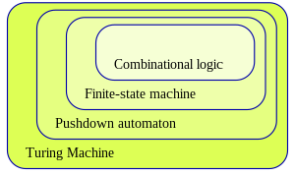
APPLICATONS OF FINITE AUTOMETA IN SEARCH ENGINES
PATTERN MATCHING
KEYWORD MATCHING
SPELL CHECKING
QUERY PARSING
NATURAL LANGUAGE PROCESSING

Slide 13
Finite autometa are used to recognize patterns:
Finite automata (FA) can be used to recognize patterns within strings by modeling the pattern as a sequence of states and transitions. Each state represents a partial match of the pattern, and each transition represents the consumption of an input symbol that extends the partial match.
They take a string of symbols as input and change their state accordingly. When the desired symbol is found, a transition occurs.

Slide 14
Finite automata (fa) can be used to implement pattern matching algorithms for search engines When we search for a string in a notepad/word file or browser or database, pattern searching algorithms are used to show the search results

Slide 15
PATTERN MATCHING IN SEARCH ENGINES
Pattern matching plays a crucial role in enabling search engines to provide users with fast and accurate search results
When a user enters a search query, the search engine uses pattern matching algorithms to find pages in its index that contain the keywords or phrases specified in the query. These algorithms can also identify synonyms and common spelling errors to expand the scope of the search and provide more comprehensive results.

Slide 16
Compiler design: Finite automata are used in the lexical analysis phase of a compiler. They are used to recognize and tokenize the input program based on the syntax of the programming language.
Pattern recognition: Finite automata are used in pattern recognition applications such as speech recognition, image recognition, and handwriting recognition. They are used to recognize patterns based on a set of rules or constraints.
Natural language processing: Finite automata are used in natural language processing applications such as text analysis, language translation, and voice recognition. They are used to recognize and parse the syntax and semantics of natural language.

Slide 17

ALGORITHM
1)Construct a finite automaton for the given pattern
2)Initialize the state of the automata
3)Process the text string
4)Update the state of the automaton
5)Repeat steps 3-4 until the end of the text string is reached
TIME COMPLEXITY : O(M+N)
SPACE COMPLEXITY: O(M* Σ)

Slide 18

Text: A A B A A C A A D A A B A A B A Pattern: A A B A A B A A A B A A A B A A A A B A A A C A A D A B A A B A A 0 1 2 3 4 5 6 7 8 9 10 11 12 13 14 15 16
EXAMPLE:
Input: txt[] = “AABAAACAADAABAABA"
pat[] = "ABAA"
Output:
Pattern found at index 1
Pattern found at index 10
Pattern found at index 13
PATTERN INDEX WAS FOUND AT 1,10,13

Slide 19
CONCLUSION
Finite autometa are powerful tool that can be used to understand and process language.they are widely used in applications such as search engines,compilers,and text editors.with the increasing amount of data and the need for faster and most efficient processing.finite autometa will become even more important in the future.Search engines are made simple with the help of finite autometa

Slide 20

Thank you
Kalyan Chakravarthy
21BAI1759

